Slide 1
TDD with ChatGPT
Llewellyn Falco
Notes:
https://chatgpt.com/c/724739f2-321d-455b-b882-84645a21c626

Slide 2
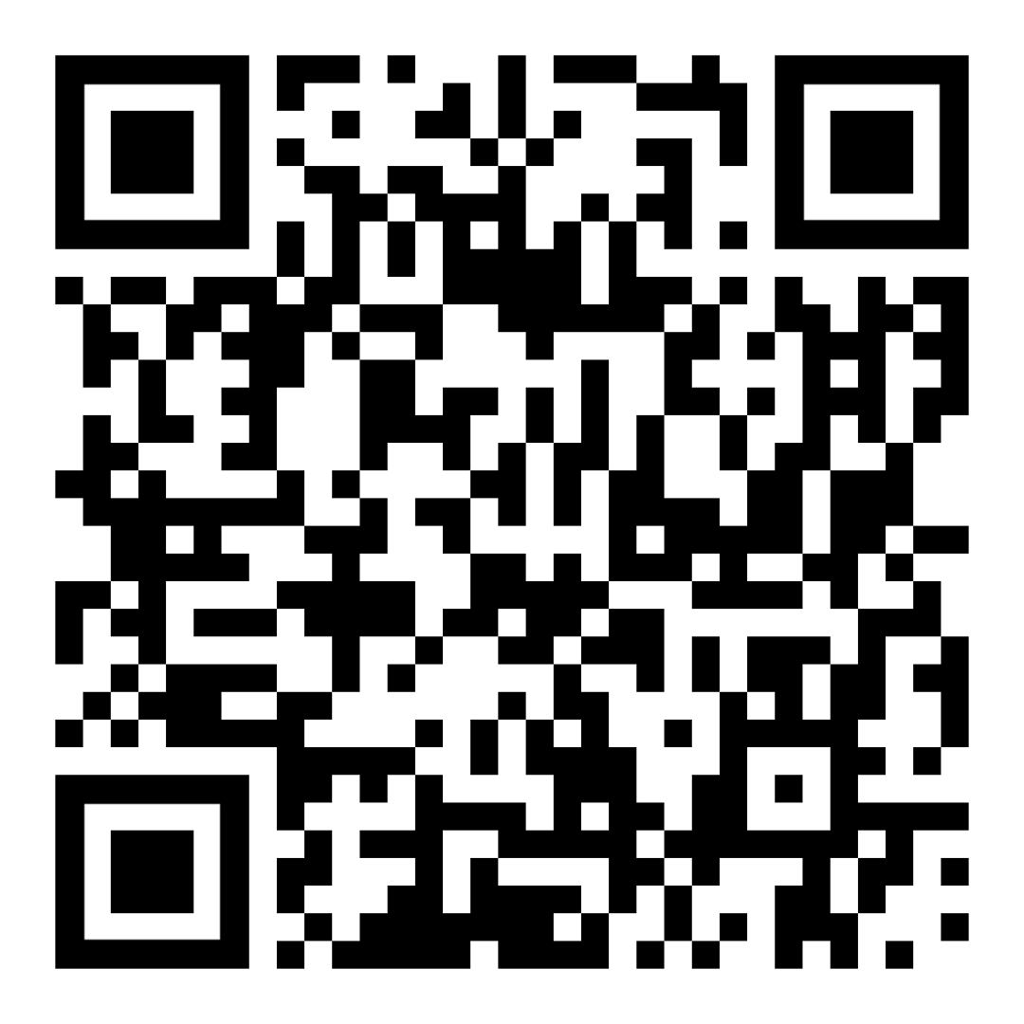
Resources
https://github.com/isidore/Talks/blob/master/TddWithChatGpt
Notes:
https://github.com/isidore/Talks/blob/master/ChatGPTPrompting.md

Slide 3
Today is May 15th 2024 – 1:30 pm MST

Slide 4
New Technology & Battle

Slide 5


Slide 6
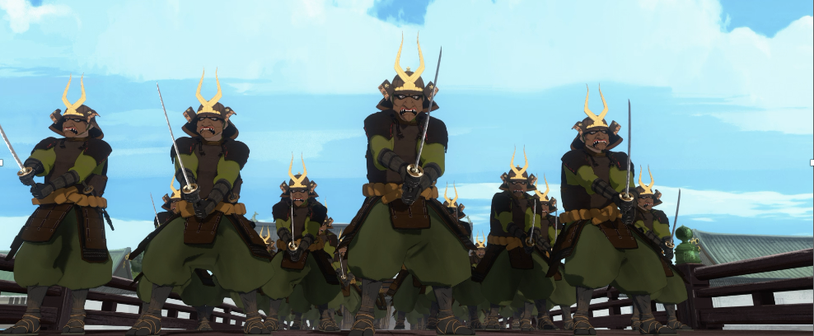
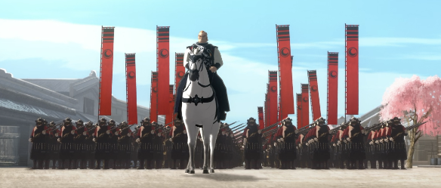
Programmer of 2022
vs
Programmer of 2025

Slide 7
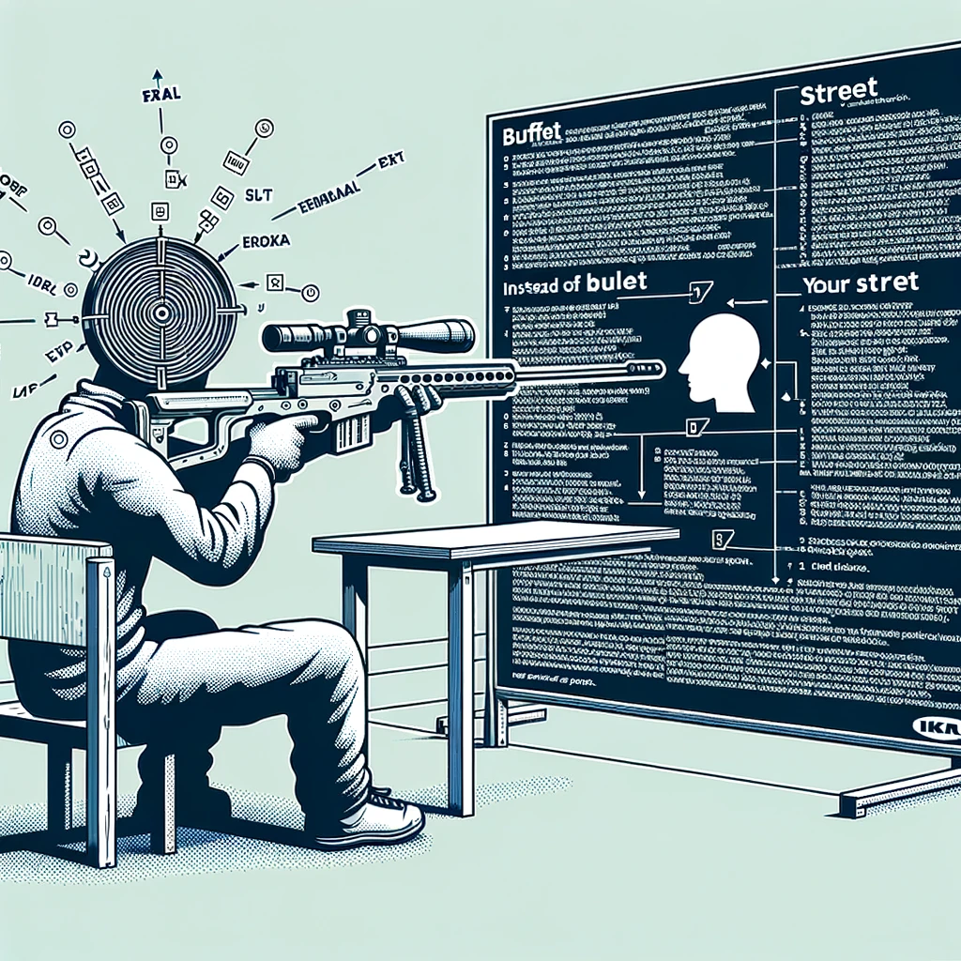
Concept Zero Shot Prompting

Slide 8
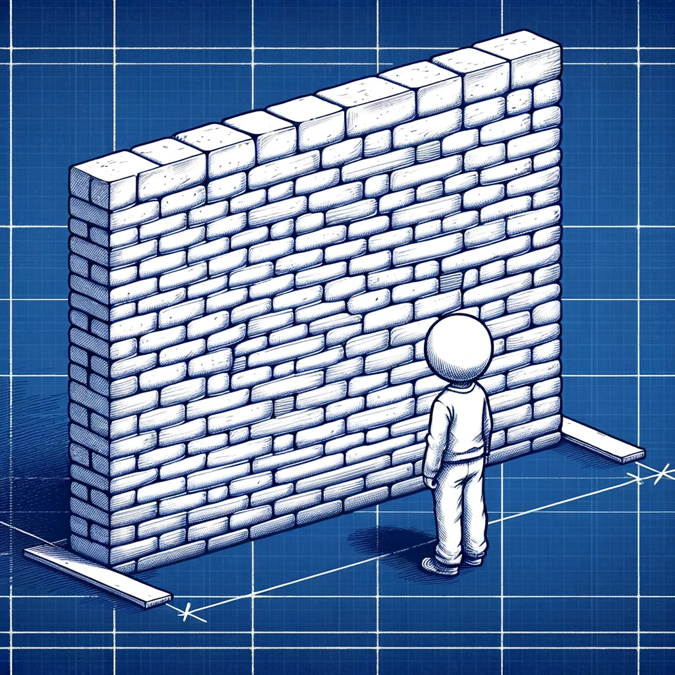
Concept The Wall
?
?
?
?

Slide 9

Hackea (Hack + Ikea) &Other ways of getting what you want

Slide 10
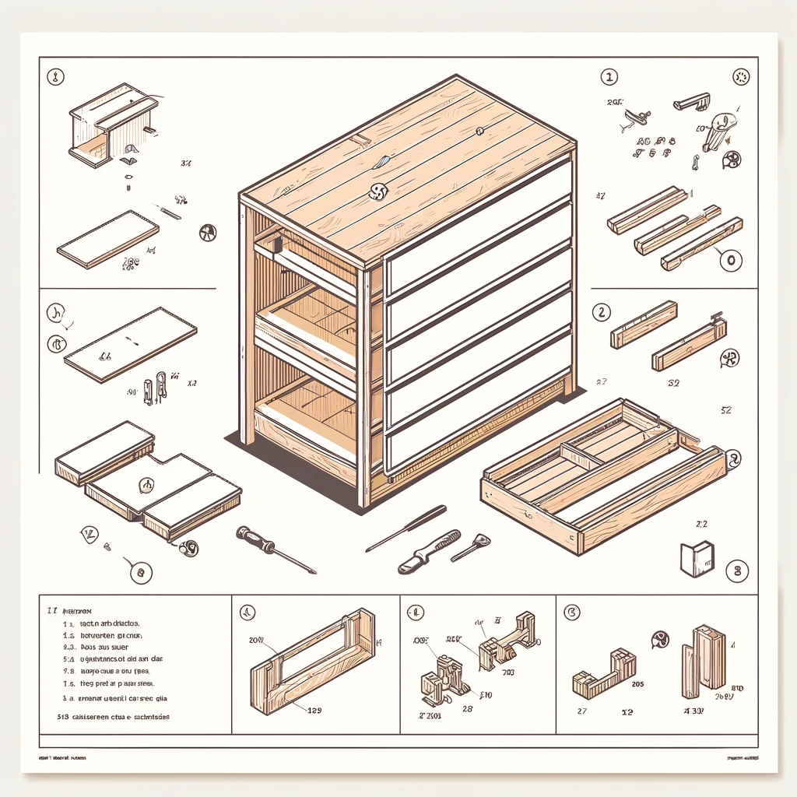
Parts Some assembly required

Slide 11

Concept Markdown
# Header 1
## Header 2
Inline `code` example **Bold:** text
*Italic:* text

Slide 12
#3 TDD & the 4 benefits of tests

Slide 13
1. Specification
2. Feedback
3. Regression
4. Granularity
- what am I going to write?
- did it work?
- does it still work?
- why did it stop working?
The 4 Benefits of Tests

Slide 14
Concept GitHub Co-pilot really good autocomplete
I can | complete your thoughts.

Slide 15
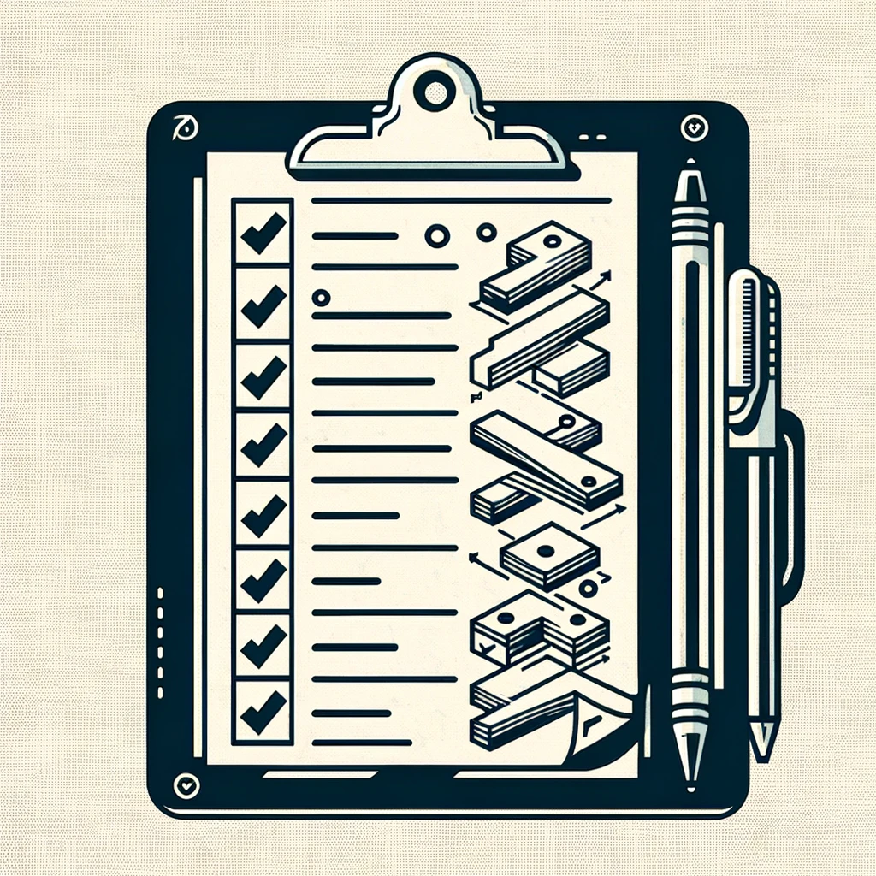
Concept Multi-step Prompt Here’s the plan, Here’s the details

Slide 16
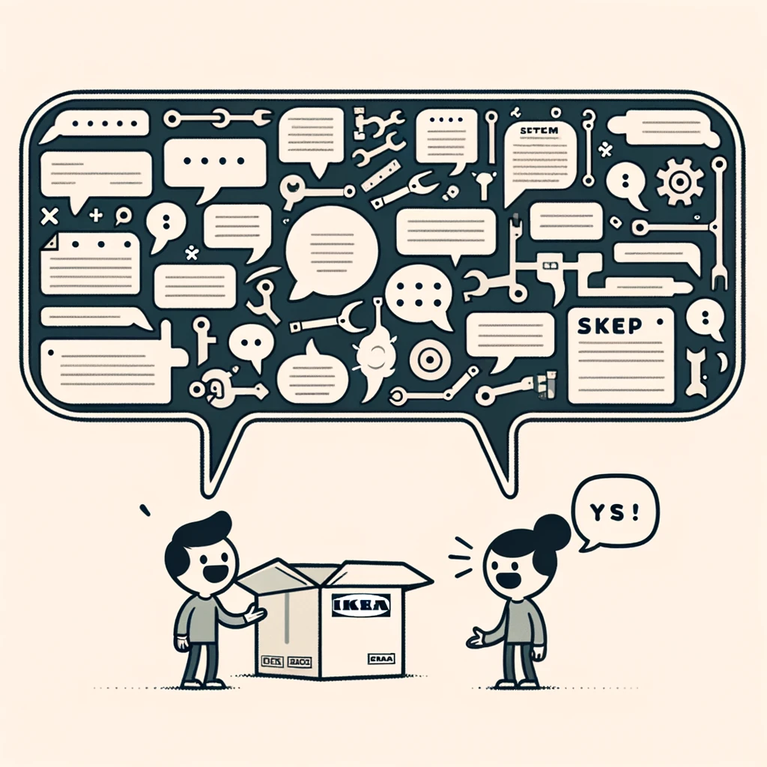
Concept Just the code no explainations

Slide 17
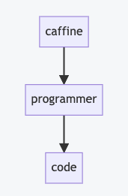
Concept Mermaid
```mermaid flowchart caffine --> programmer
programmer --> code ```

Slide 18
Safety & Knowing if something works

Slide 19
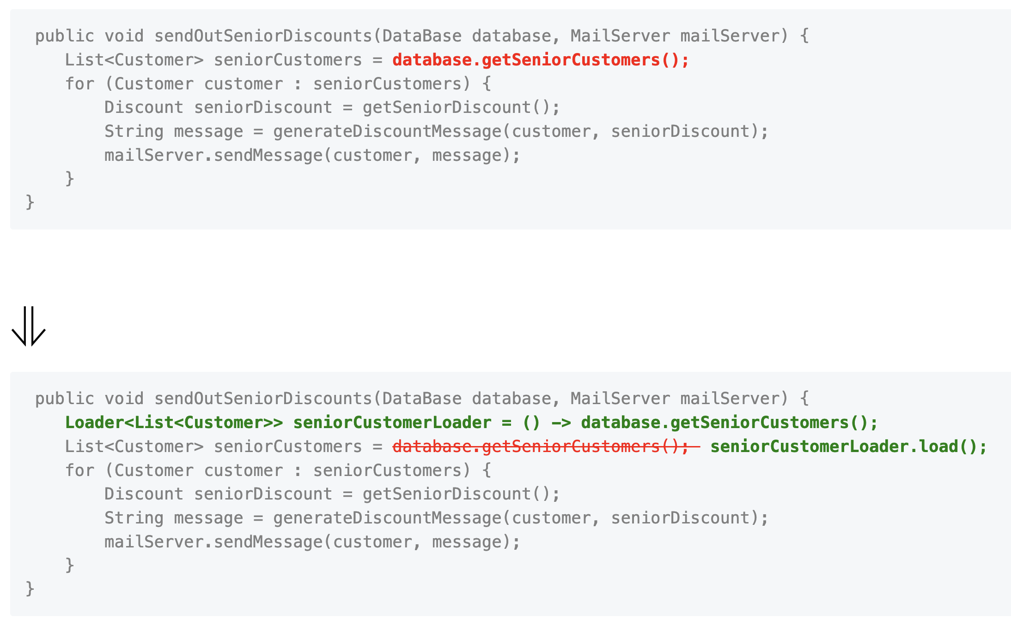

Slide 20
#1 Zero Shot Make it so…

Slide 21
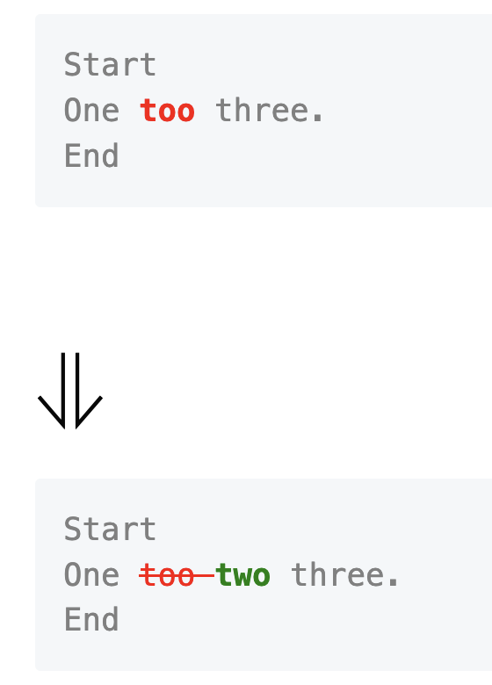
Please write some java code that will compare two string, and return a list of the differences between the two strings. I would like the API to be as follows: ```java Line[] lines = Diff.of("Start\nOne too three.\nEnd", "Start\nOne two three.\nEnd"); String markdown = MarkdownRender.refactoringsOf(lines); ``` Which would produce: ```markdown <pre style="color: gray"> Start One <b style="color: red">too </b>three. End </pre> # ⇓ <pre style="color: gray"> Start One <s style="color: red">too </s><b style="color: green">two </b>three. End </pre> ```

Slide 22
#2 Zero Shot, Take Two Maybe this time?

Slide 23
# Overview | | | |-------|----------------| | start | one too three. | | end | one two three. | Give a starting line, and an ending line, I would like to be able to describe the changes between the two lines. Please write a python implementation of the Line class ### Desired API ```python line = Line.of("one ").removed("too ").added("two ").and("three.") ``` ### Additional Requirements Please make the Line class immutable. If the state needs to change, create a new instance of that class. Also, please design to the class to be dynamic with the number of changes that might occur in a line.

Slide 24
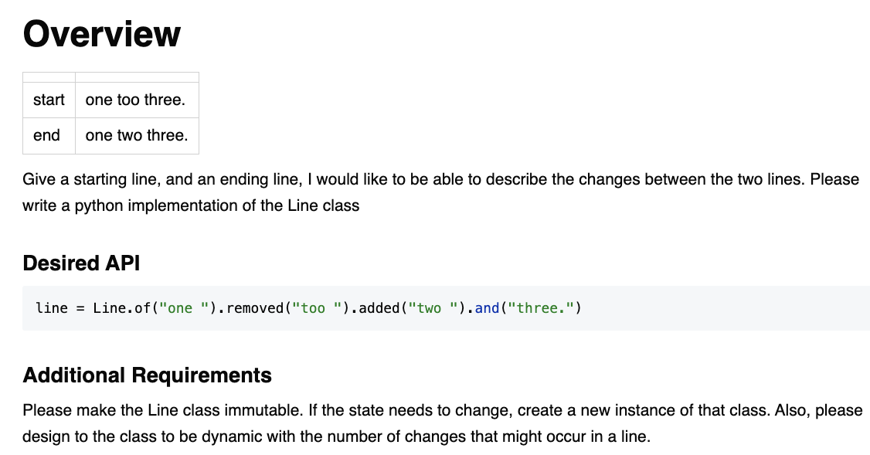

Slide 26

Resources
Thank you!
Llewellyn Falco
Please connect on LinkedIn
https://github.com/isidore/Talks/blob/master/TddWithChatGpt
Notes:
https://github.com/isidore/Talks/blob/master/ChatGPTPrompting.md

